Slide 1

Scientific Data management Project
Team Members:
1- Doaa Sayed Ibrahim Morsy
2- Ahmed Mohsen Mohamed Ahmed
3- Ahmed Khaled Nour El-Hady Ahmed
4- Merihan Youssef Abdel-Nasser Abdel-Aziz
5- Toqa Abdel-Sattar Mohamed Ali
6- Aya Omar Mosa Ismail

Slide 2
Content:
Introduction | Brief introduction about project title.
Description | Detailed Description about dataset.
Pre-Processing | Processes to prepare data for analysis.
Visualization | Visualize using R programming Language.
Ontology & SPARQL | Ontogoly on Renin enzyme and query on it.
Annotation | Annotation of Renin Ontology.
Prediction | Code to predict chronic kidney disease.
Refrenced Programs:
OpenRefine , Proteoge , RightField , Rstudio
Link to Dataset:
Kidney Disease Dataset | Kaggle

Slide 3
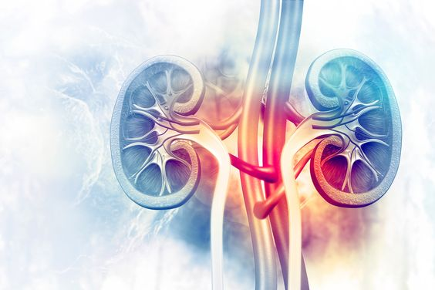
Chronic Kideny Disease

Slide 4

Introduction
Brief introduction about chronic kidney disease.

Slide 5
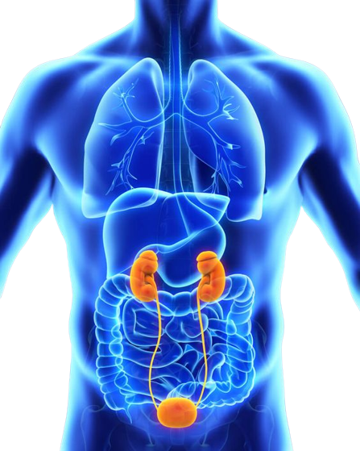
Chronic Kidney Disease:
Chronic kidney disease, also called chronic kidney failure, involves a gradual loss of kidney function. Your kidneys filter wastes and excess fluids from your blood, which are then removed in your urine.
Advanced chronic kidney disease can cause dangerous levels of fluid, electrolytes and wastes to build up in your body.
In the early stages of chronic kidney disease, one might have few signs or symptoms. One might not realize that you have kidney disease until the condition is advanced.

Slide 6

Dataset Description
01
The dataset is taken over 2-month period in India. It has 400 rows with 25 features like red blood cells, pedal edema, sugar, etc.….

Slide 7
Dataset Attributes:
Meaning | Attribute
Age of the patient. | Age
Blood pressure. | bp
Specific gravity. | sg
Albumin. | al
Sugar. | su
Red blood cells. | rbc
Pus cells. | pc
Pus cells clumps. | pcc
Bacteria. | ba
Blood glucose random. | bgr
Blood urea. | bu
Serum creatinine. | sc
Sodium. | sod
Potassium. | pot
Hemoglobin. | hemo
Packed cell volume. | pcv
White blood cells count. | wc
Red blood cells count. | rc
Hypertension. | htn
Diabetes mellitus. | dm
Coronary artery disease. | cad
Appetite. | appet
Pedal edema. | pe
Anemia. | ane
Classification of having disease or not. | class

Slide 8

Values | Number of Instances
CKD: 250 NotCKD : 150 | 400
Type | Number of Attributes
Numeric: 11 Nominal : 14 | 24 + Classification label

Slide 9

Dataset Pre-processing
02
Cleaning data using Openrefine application and filling missing values using mean of the data related to each class.

Slide 10
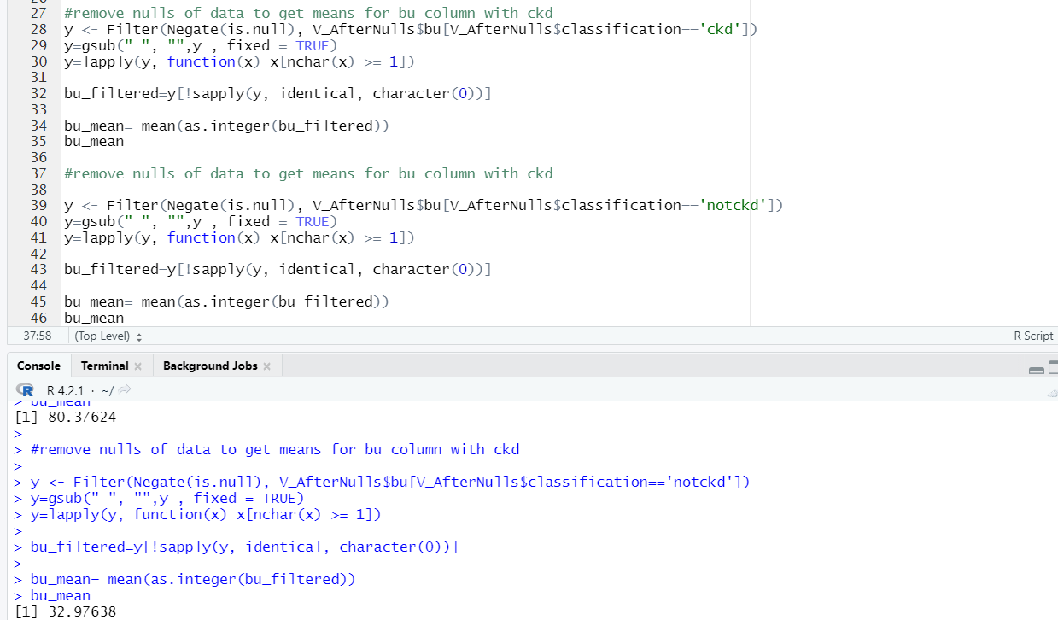
R code to get the average of bu column class

Slide 11
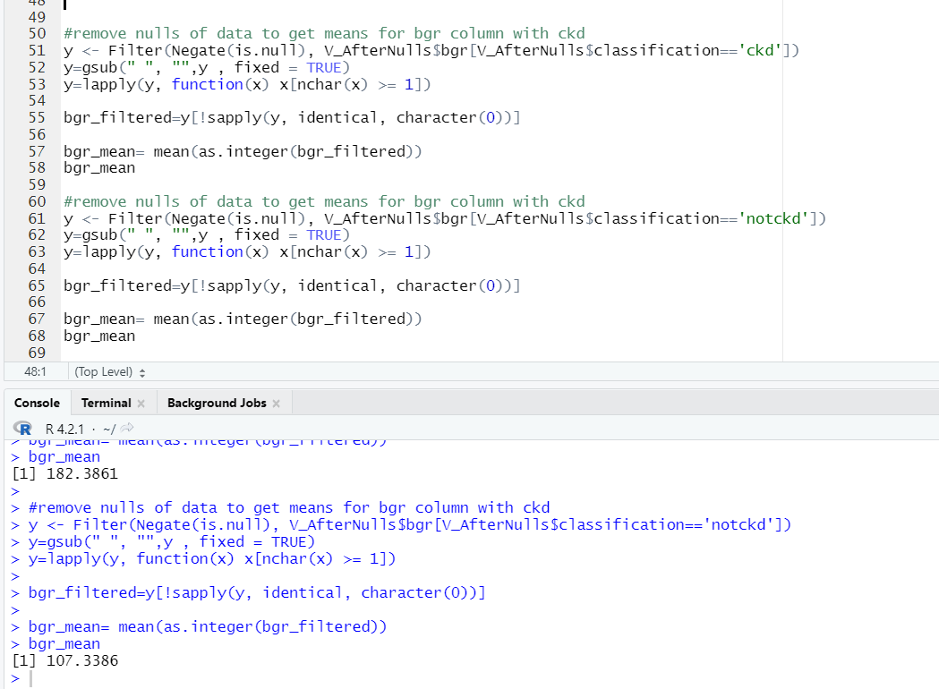
R code to get the average of bgr column class (cont.)

Slide 12
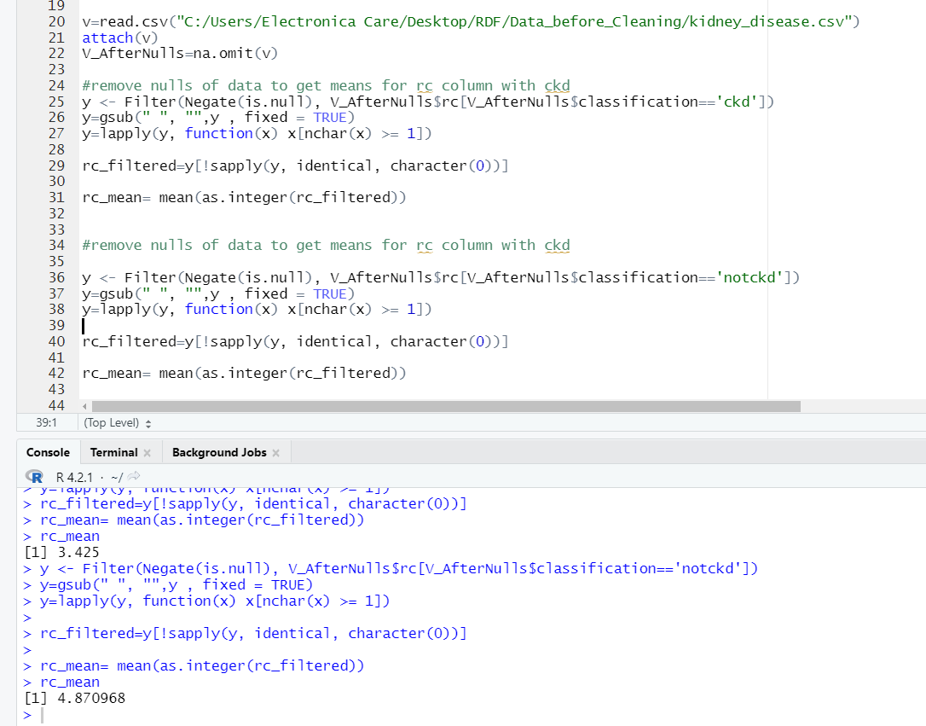
R code to get the average of rc column class (cont.)

Slide 13
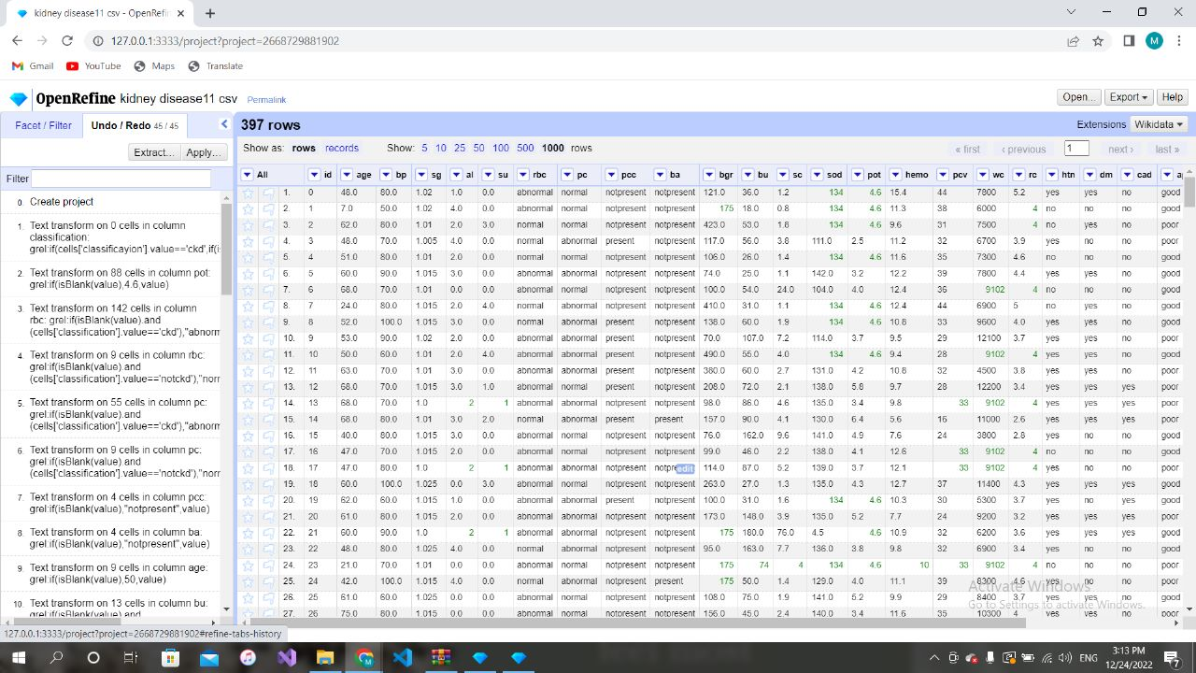
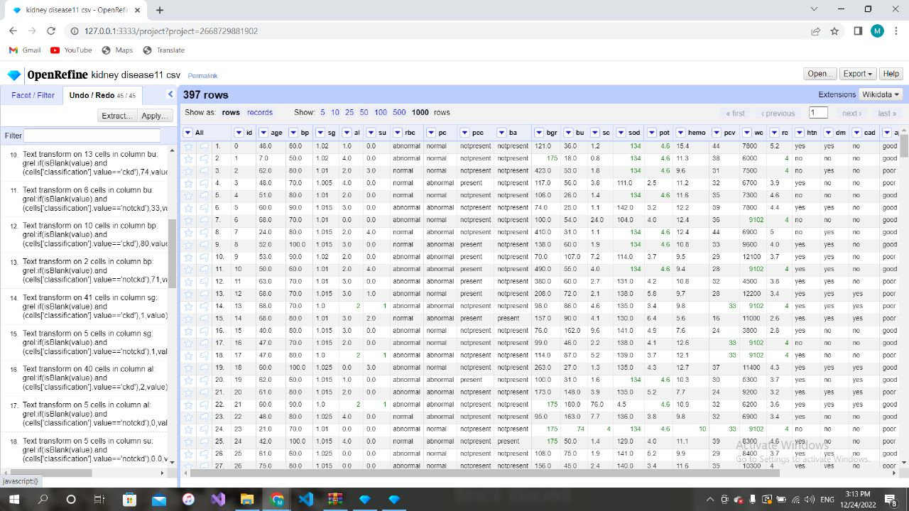
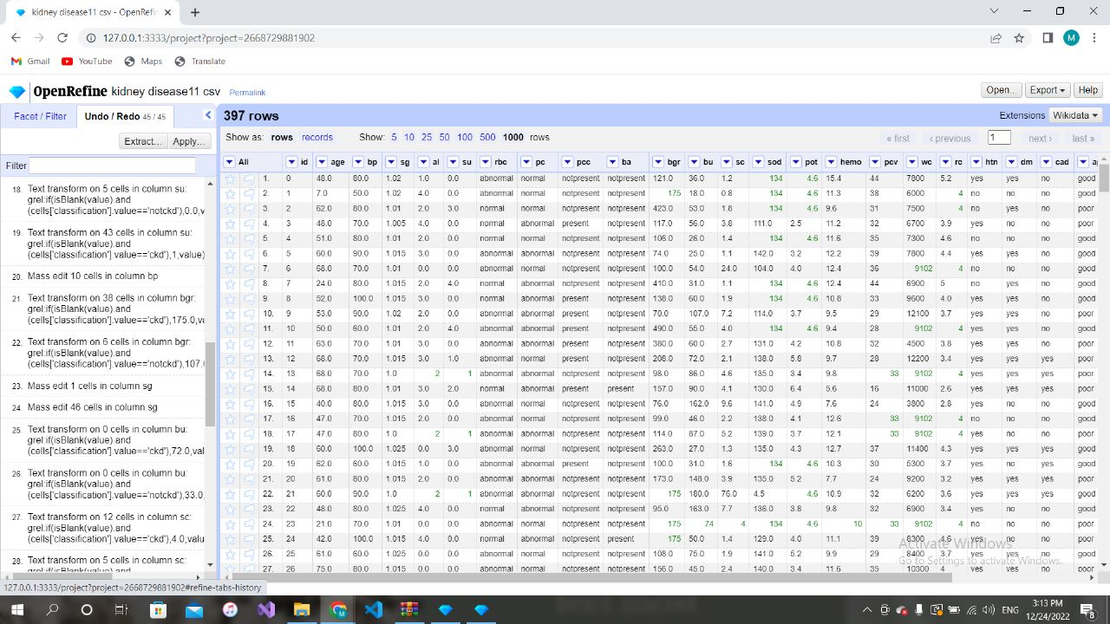

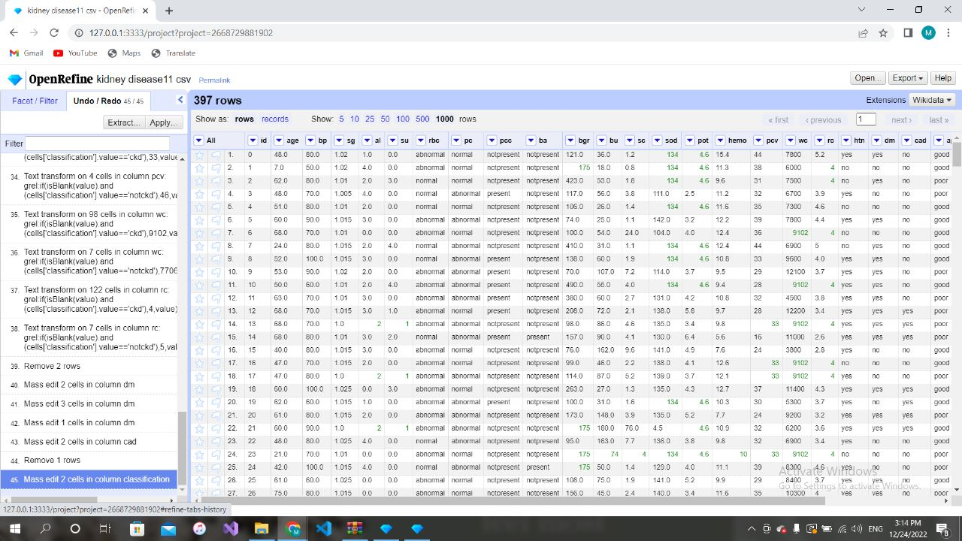
OpenRefine Processes
1
2
3
4
5

Slide 14
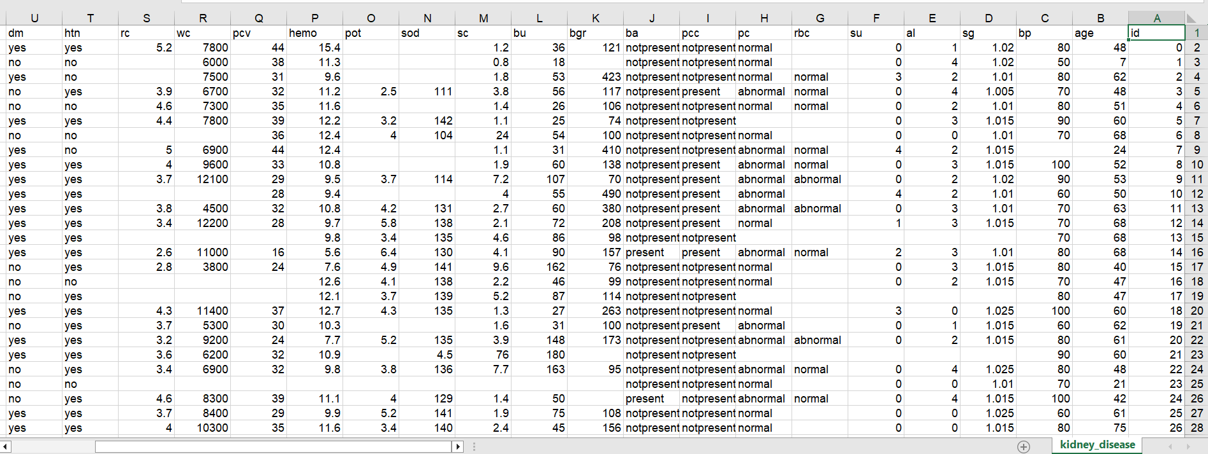
Dataset before cleaning
400 record with missing values.

Slide 15
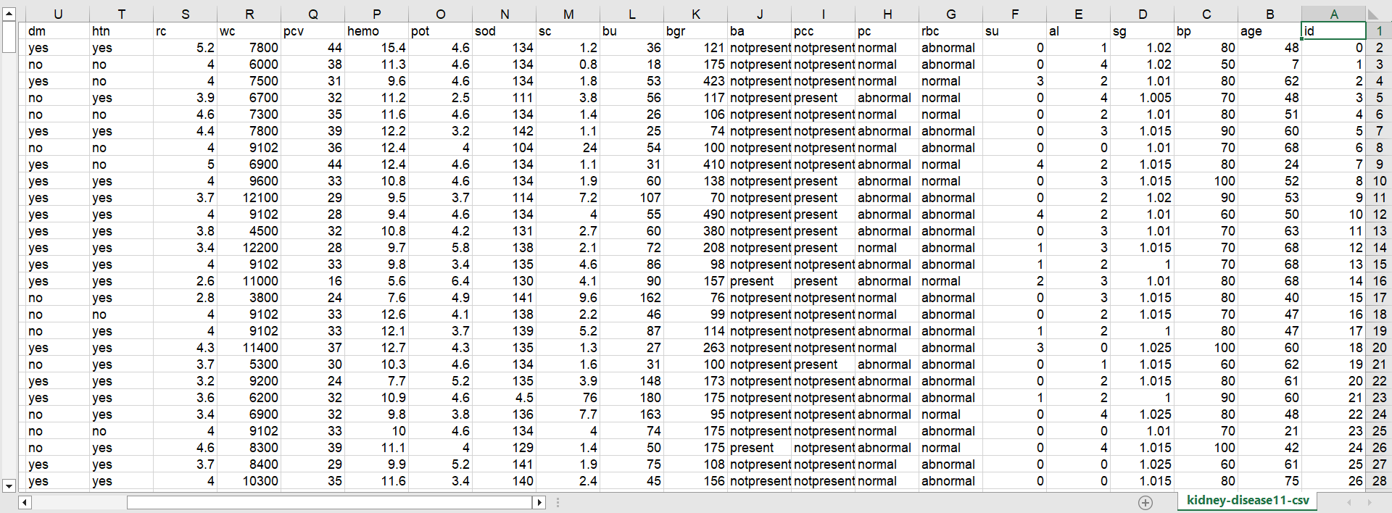
Dataset after cleaning
400 record without missing values.

Slide 16
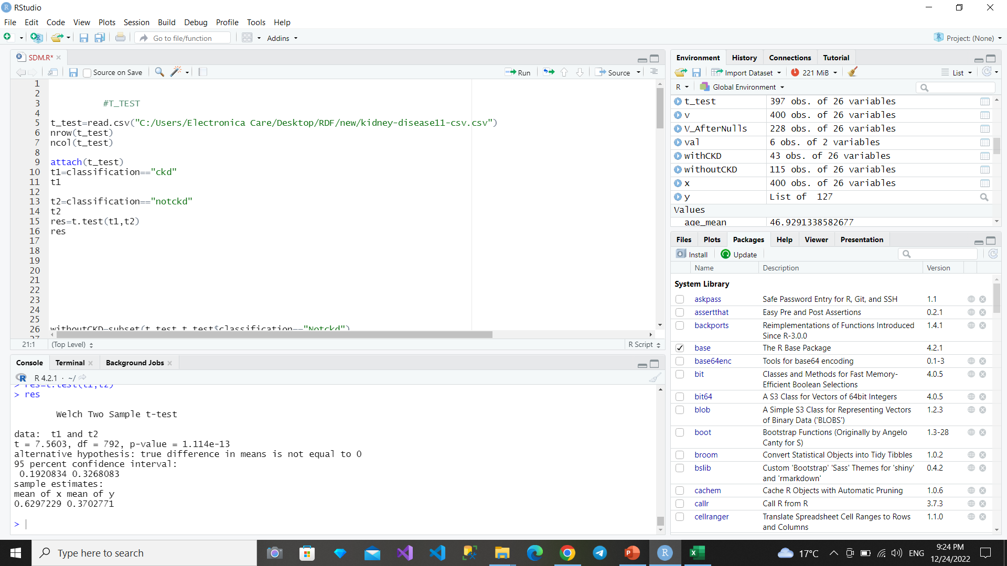
T-test
What does T-test on data mean?
That means there is difference between two groups because p-value result= 1.114e-13 which is less than 0.05 (alternative hypothesis is true) (rejected null hypothesis).
Null Hypothesis: two groups is equal in mean.
Alternative Hypothesis: groups mean is not equal.

Slide 17

Visualization
03
Visualization of data after cleaning using r programming language and plots library.

Slide 18
Content of visalizations:
01
04
02
05
03
Scatter plot
Pie Plot
Histogram
Bar plot
Plot
06
Pair Plot
07
Heat map
08
Box plot

Slide 19
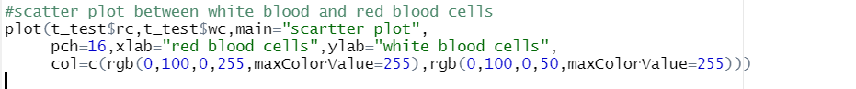
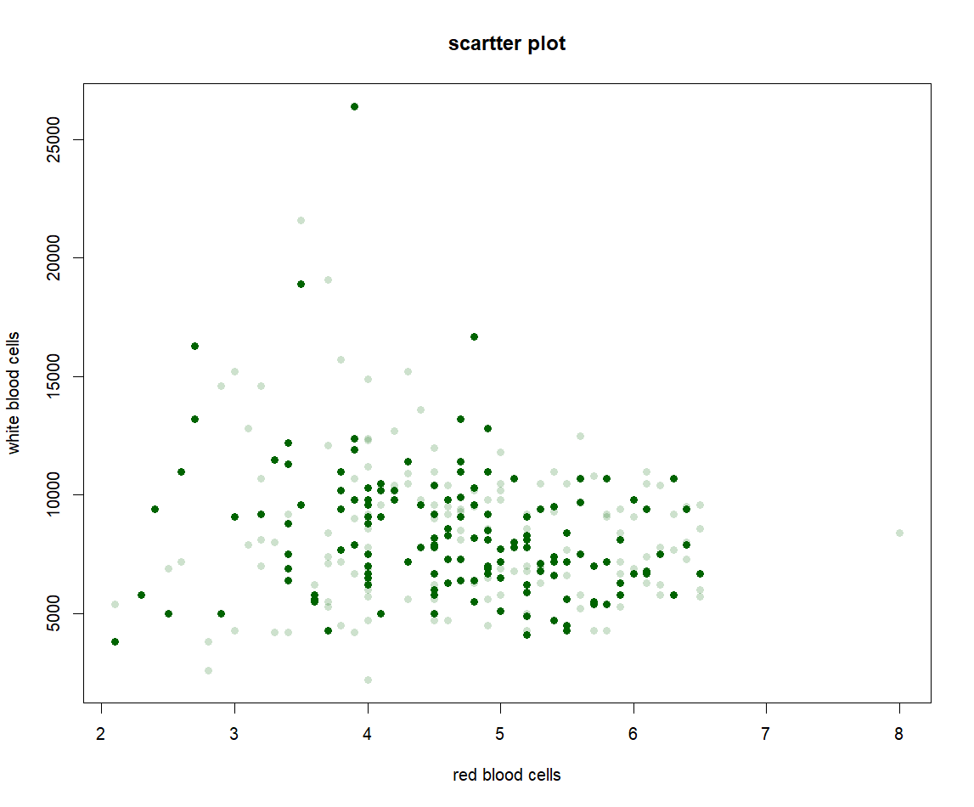
Scatter plot

Slide 20

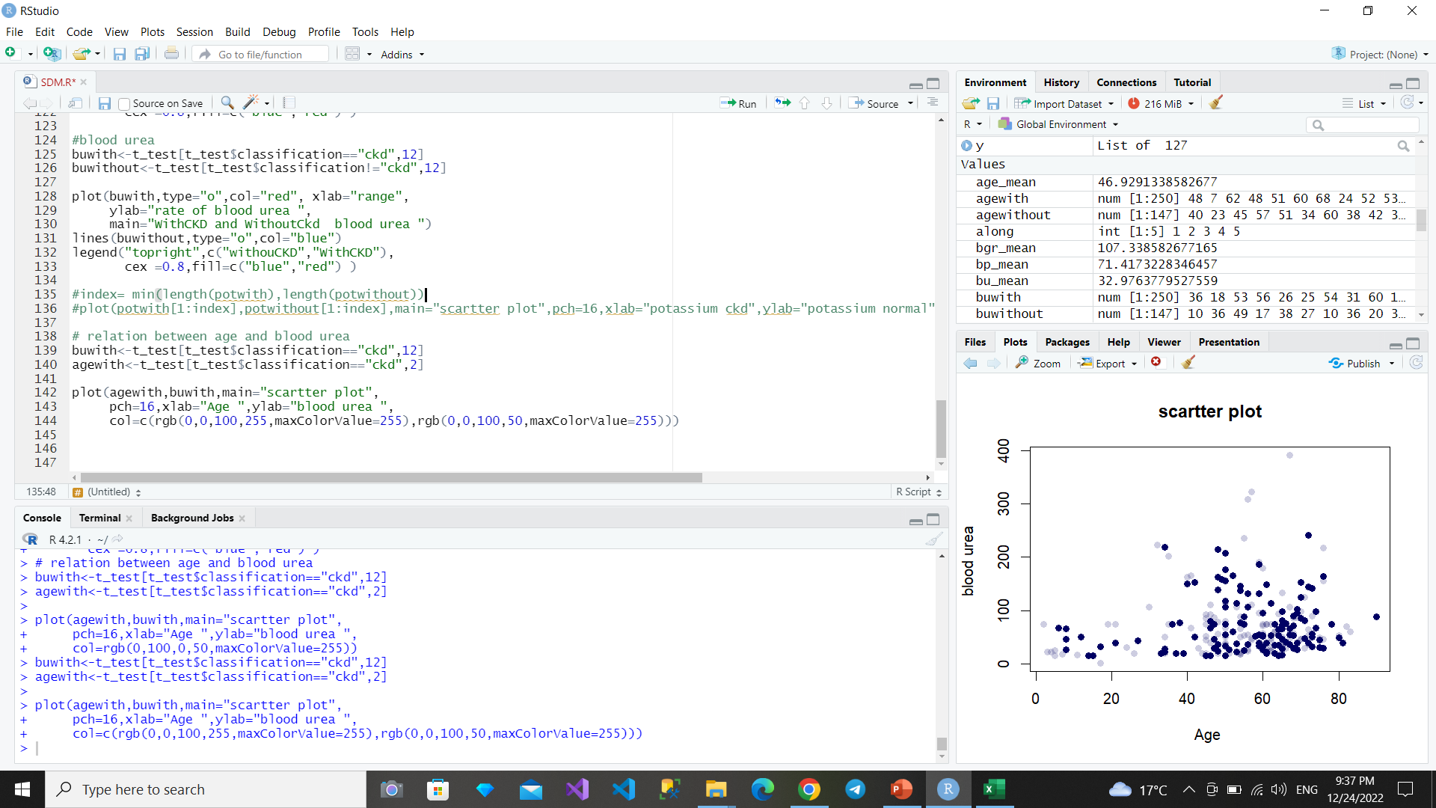
Cont..
With Chronic Kidney disease

Slide 21
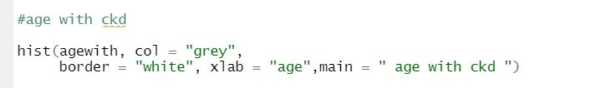
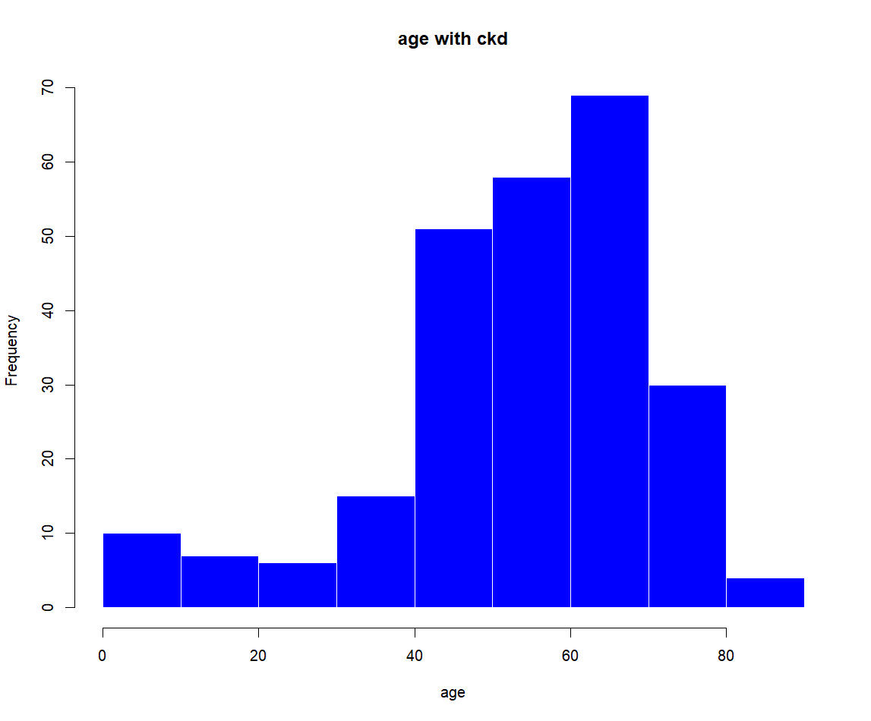
Histogram
With Chronic Kidney disease

Slide 22
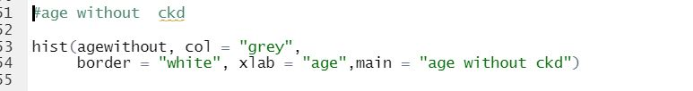
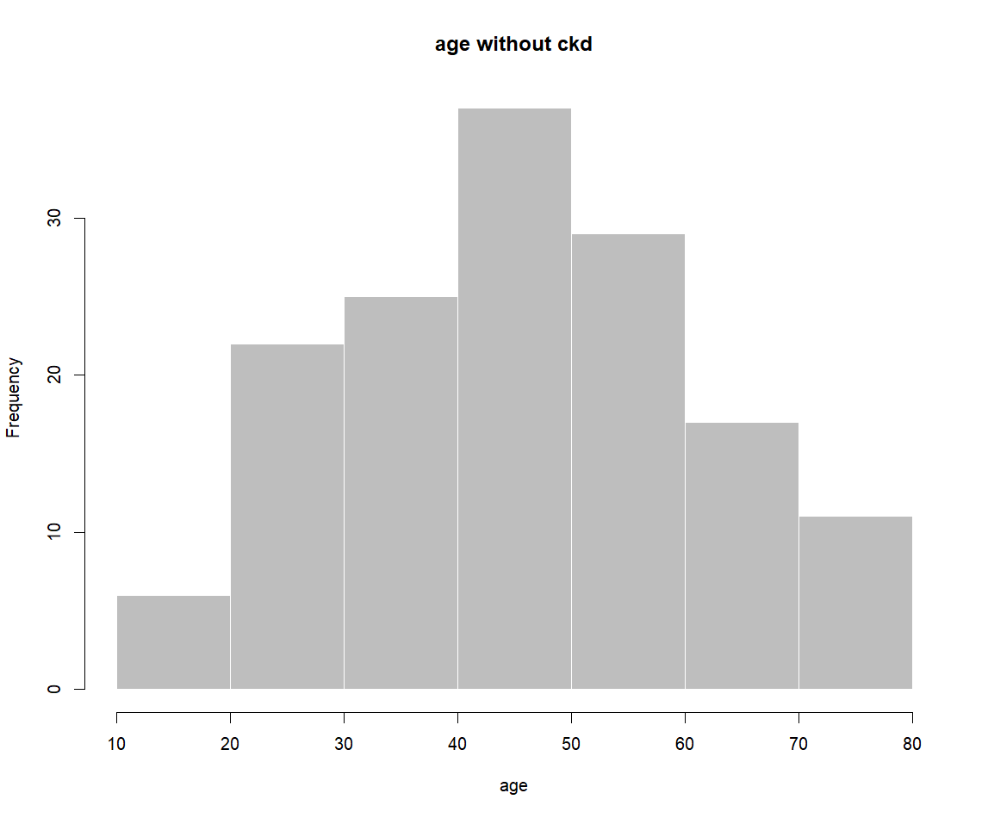
Cont..
Without Chronic Kidney disease

Slide 23
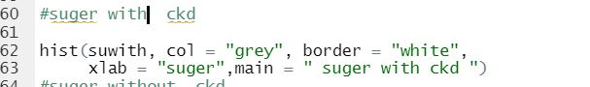
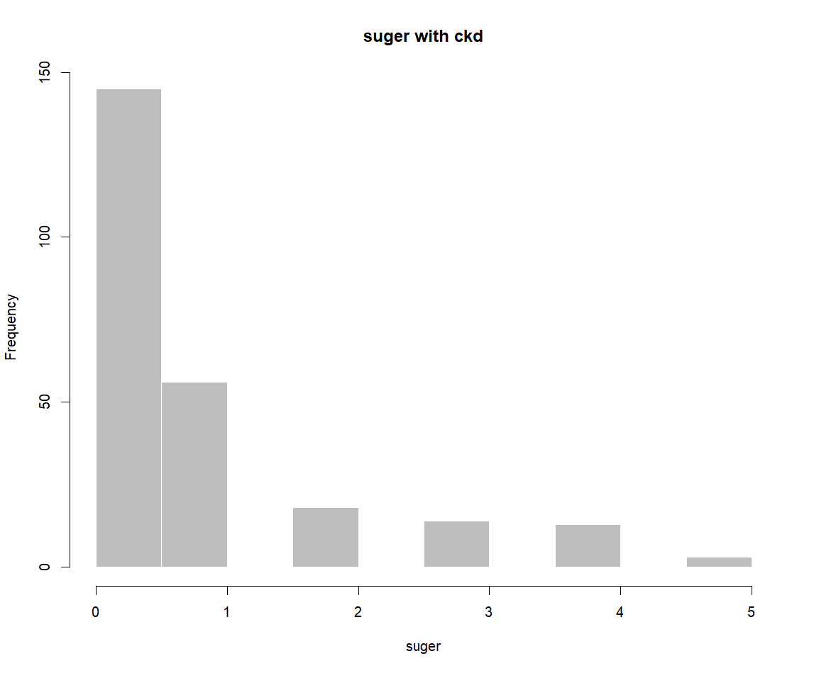
Cont..
With Chronic Kidney disease

Slide 24
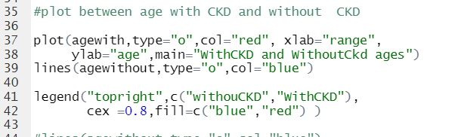
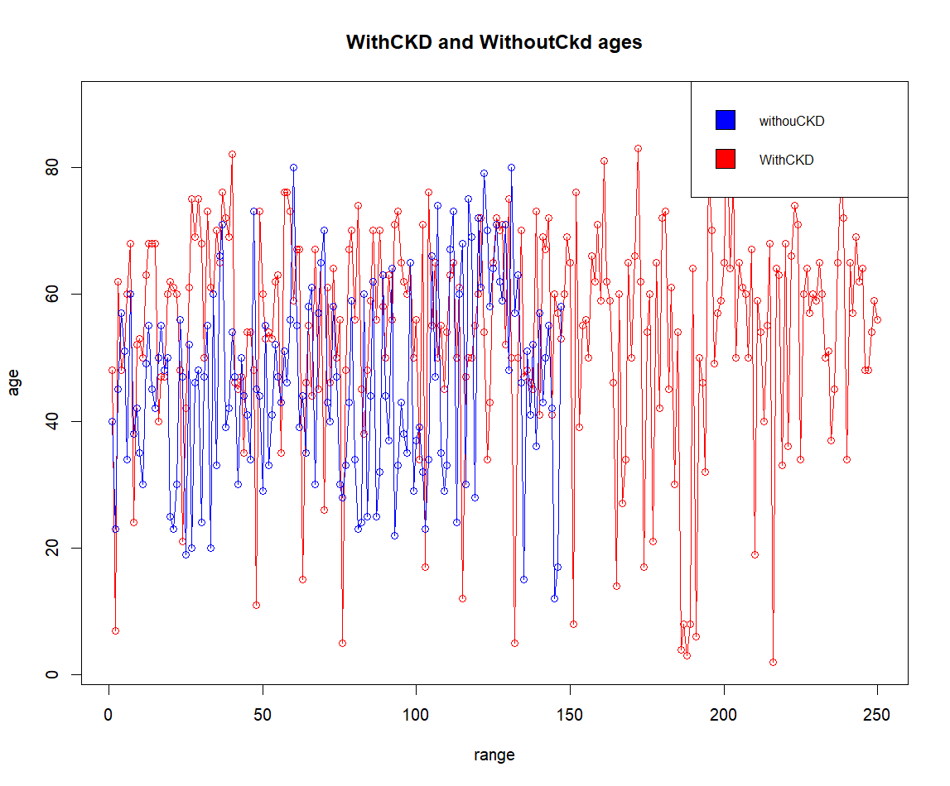
Plot

Slide 25
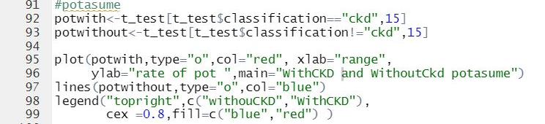
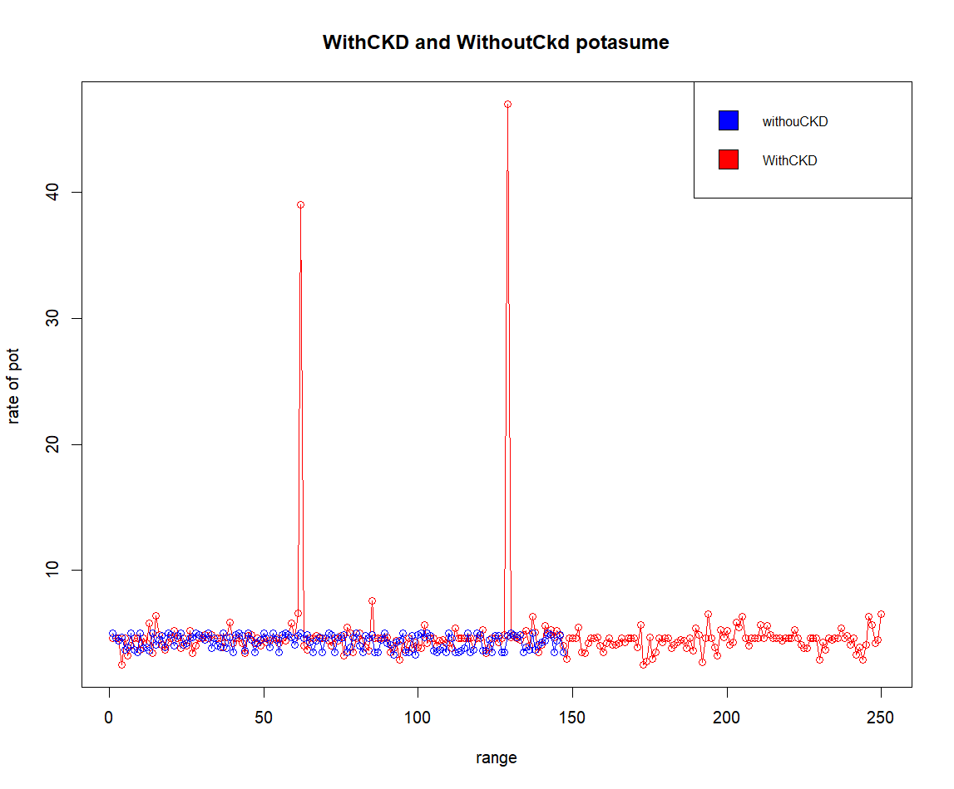
Cont..

Slide 26
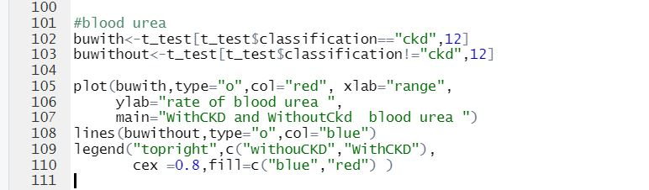
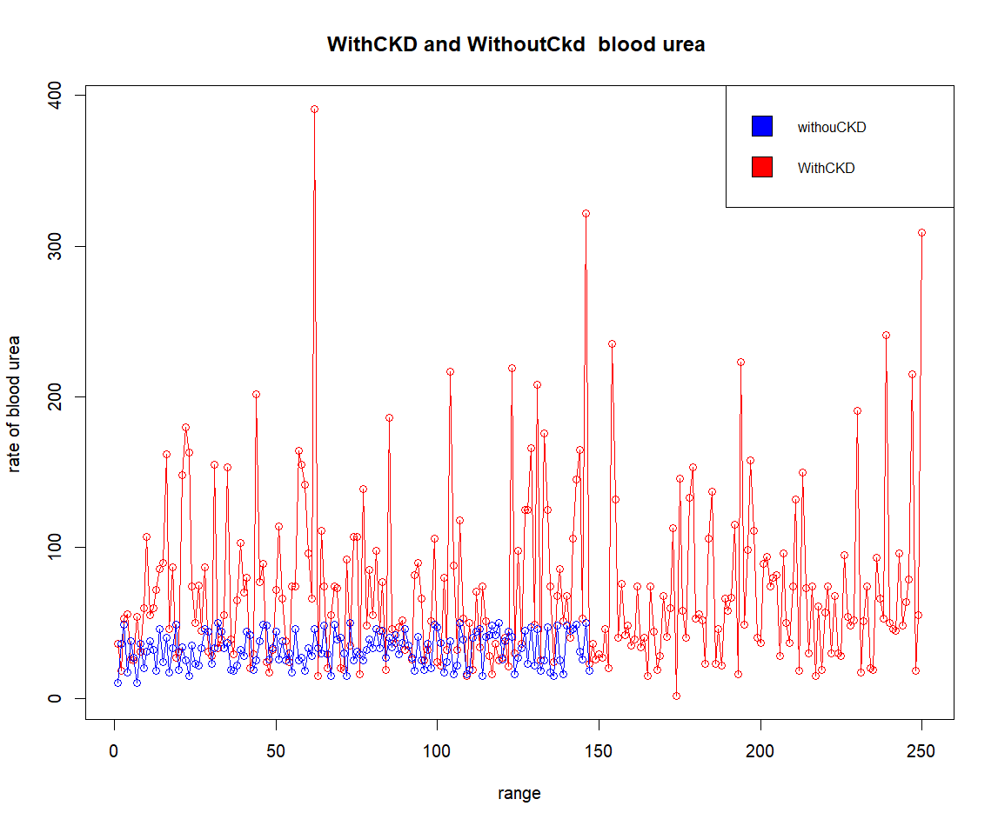
Cont..

Slide 27
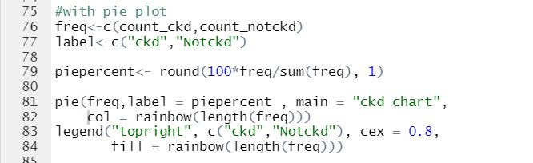
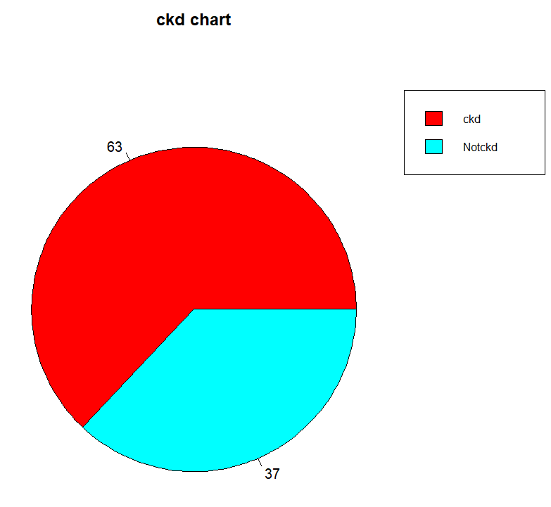
Pie plot

Slide 28
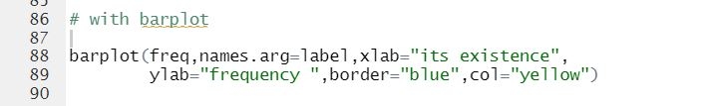
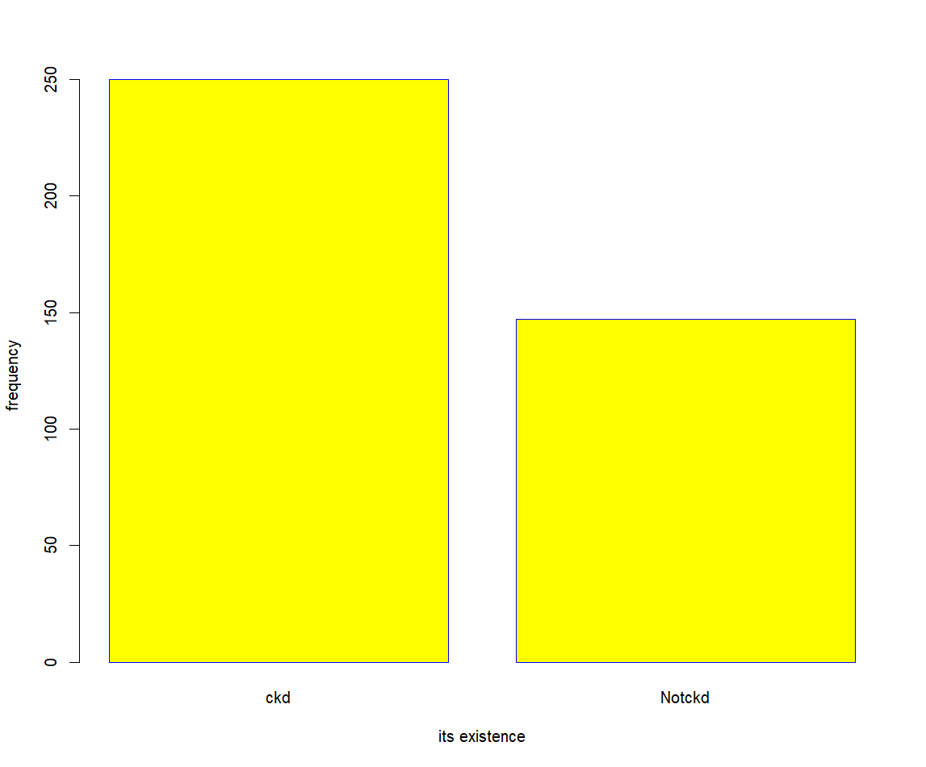
Bar plot

Slide 29
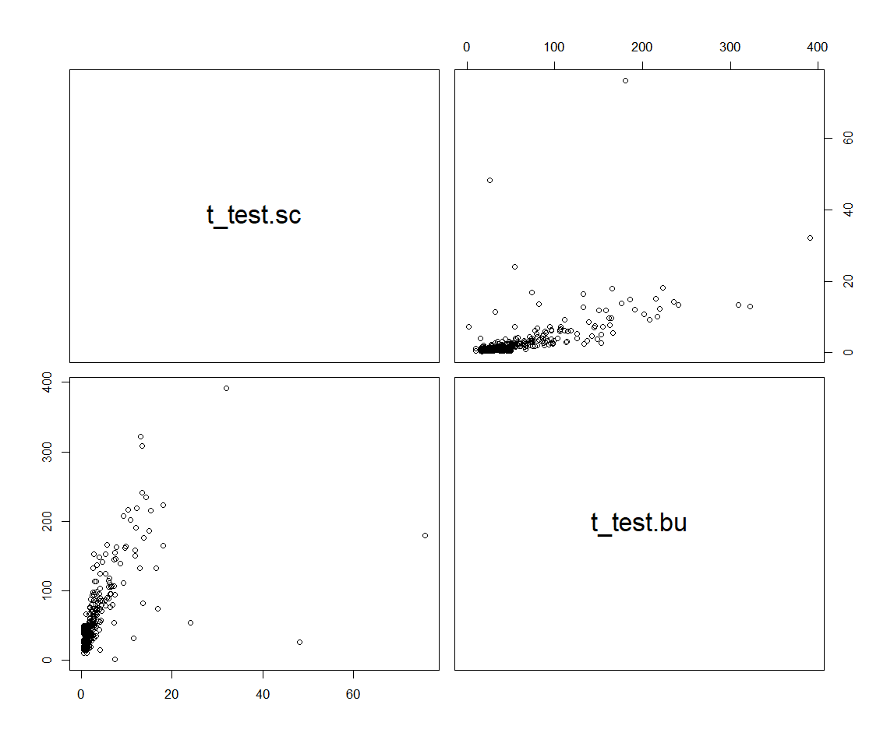
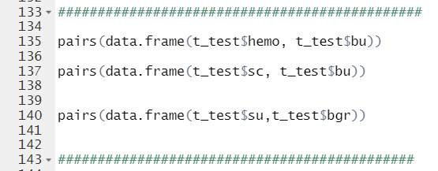
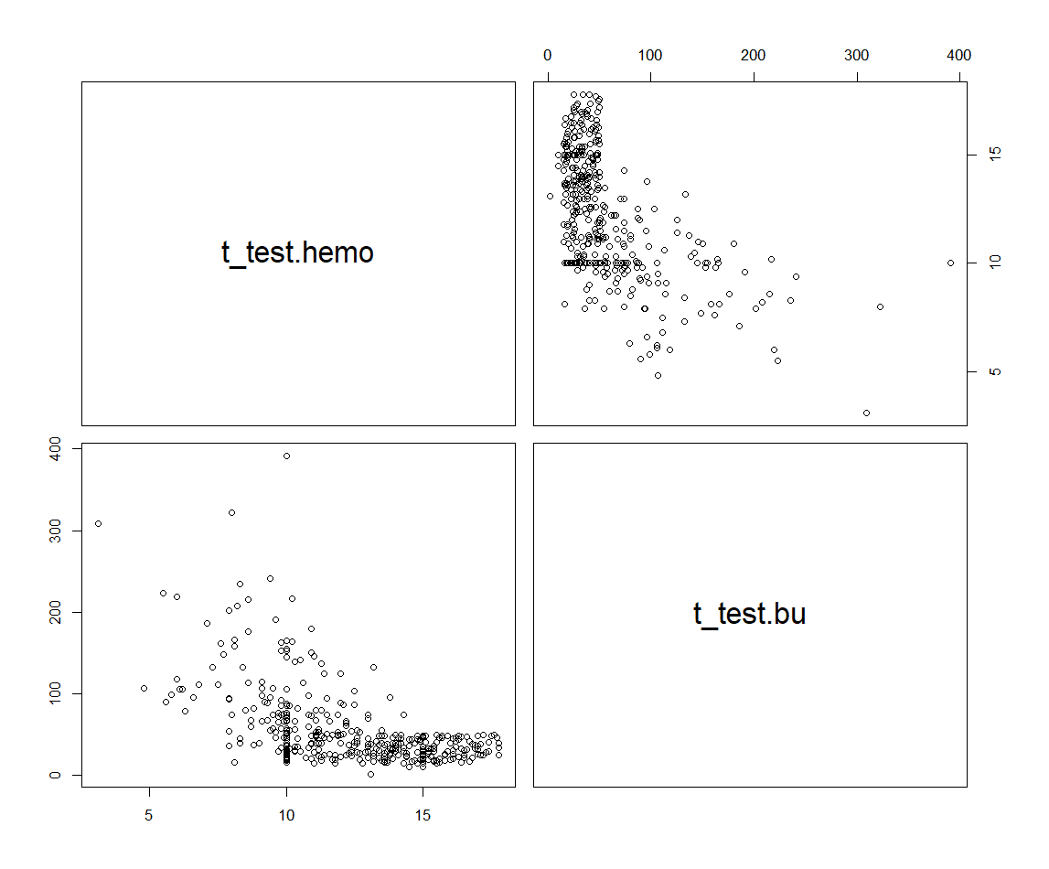
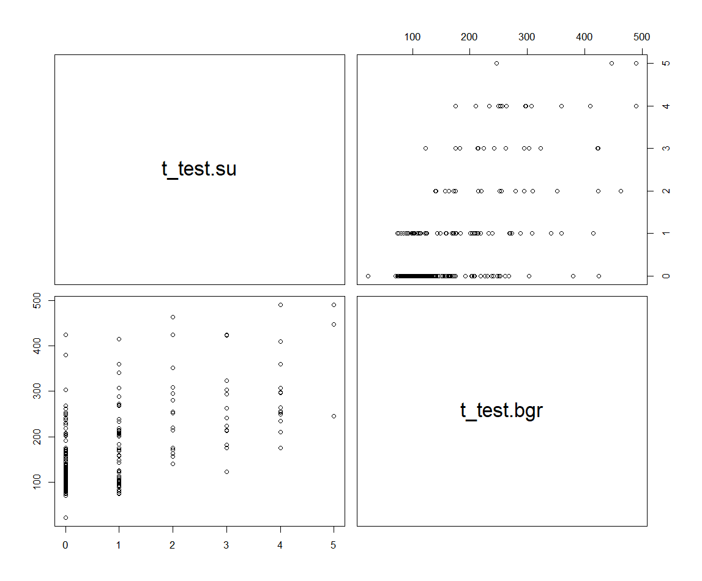
Pair plot

Slide 30
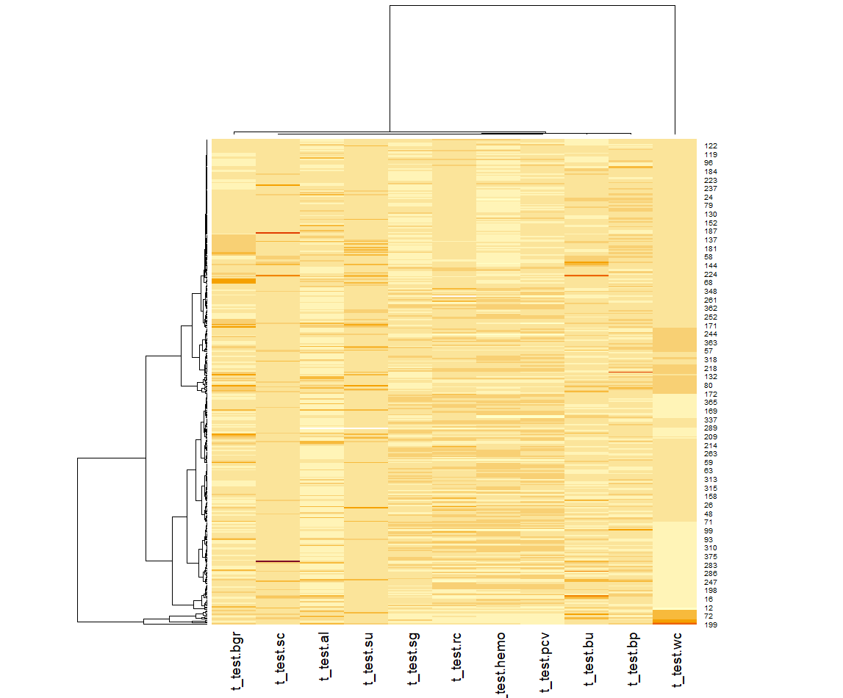
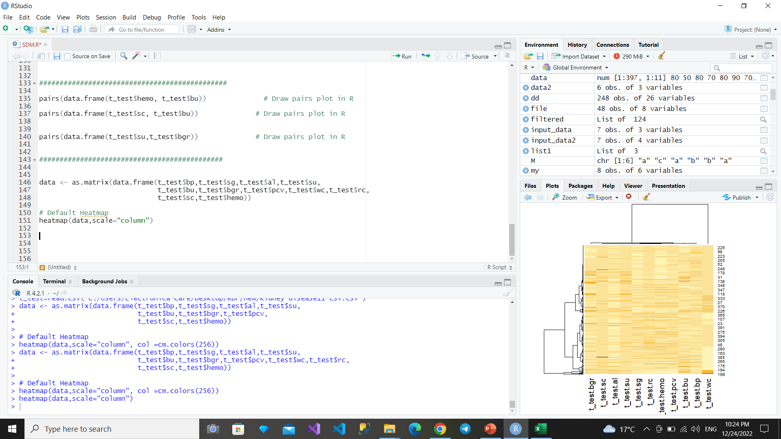
Heat map

Slide 31
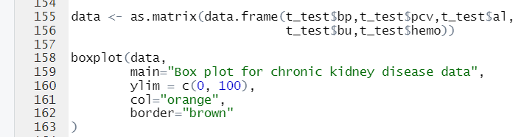
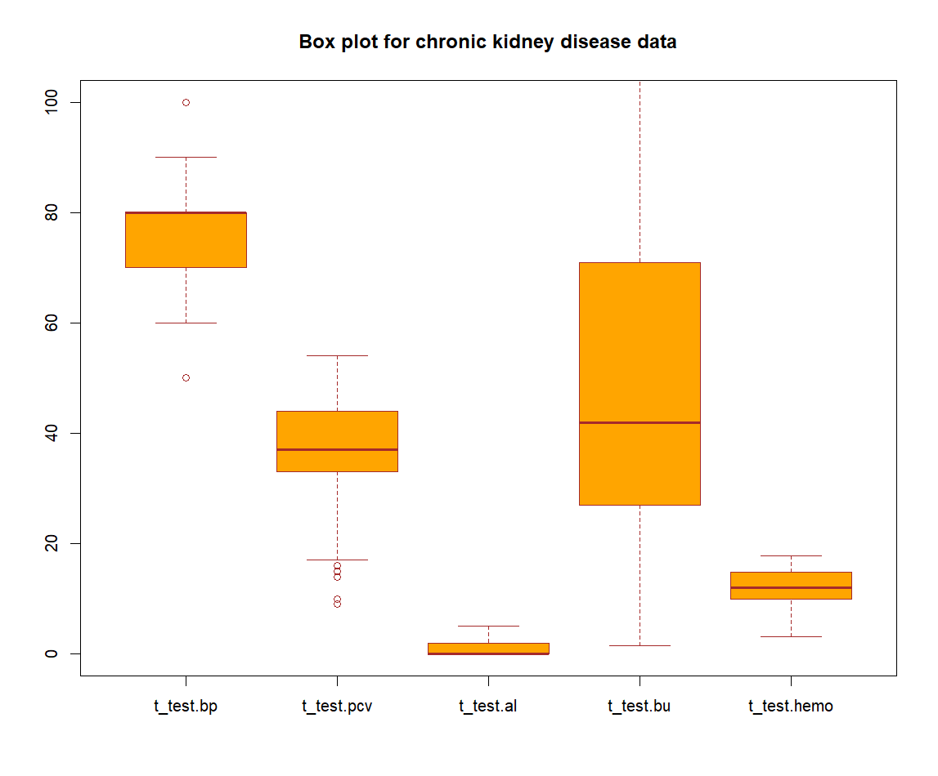
Box plot

Slide 32
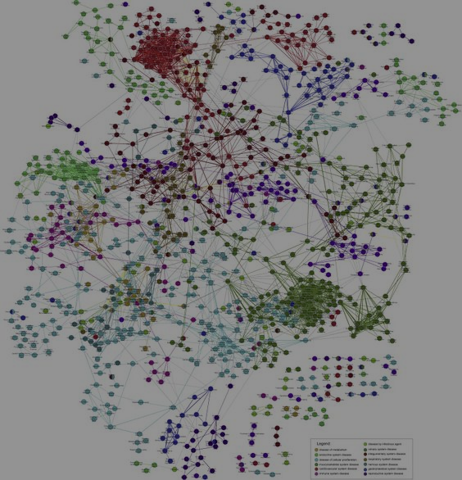
Ontology & SPARQL

Slide 33
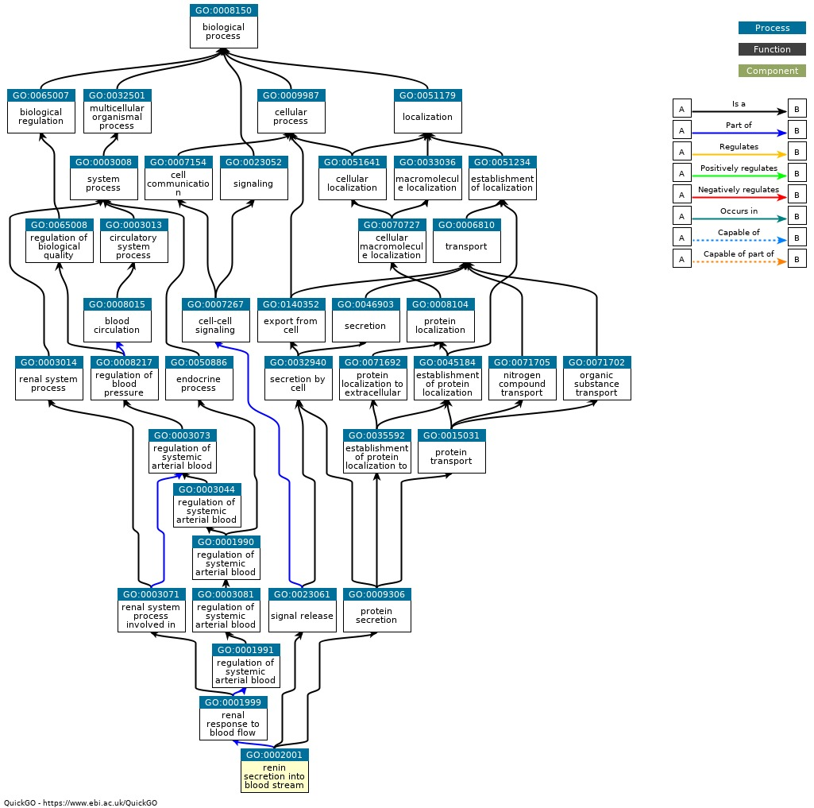
Renin Ontology (Uniprot)

Slide 34
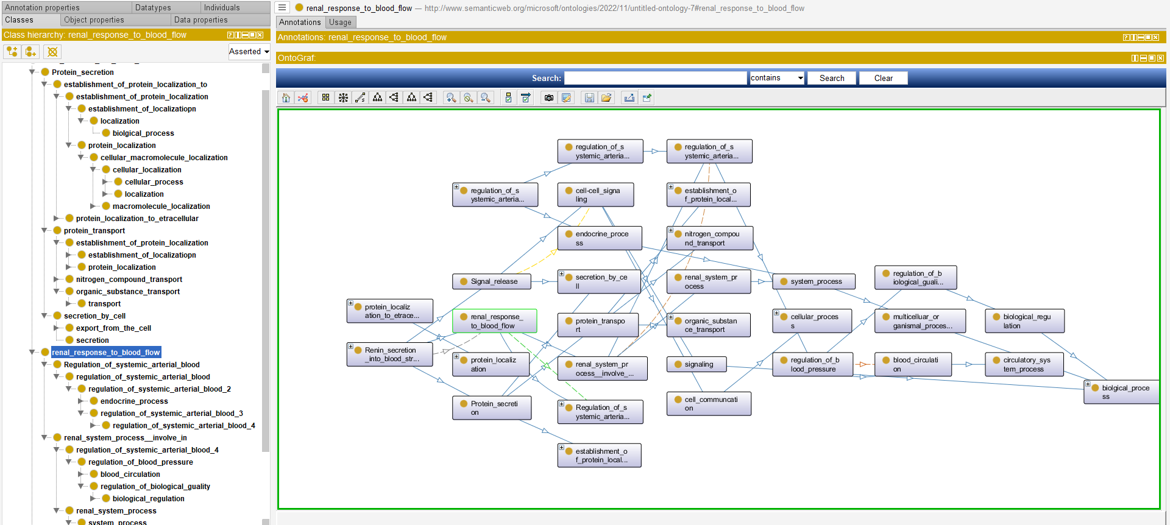
Proteoge Ontology for Renin gene

Slide 35
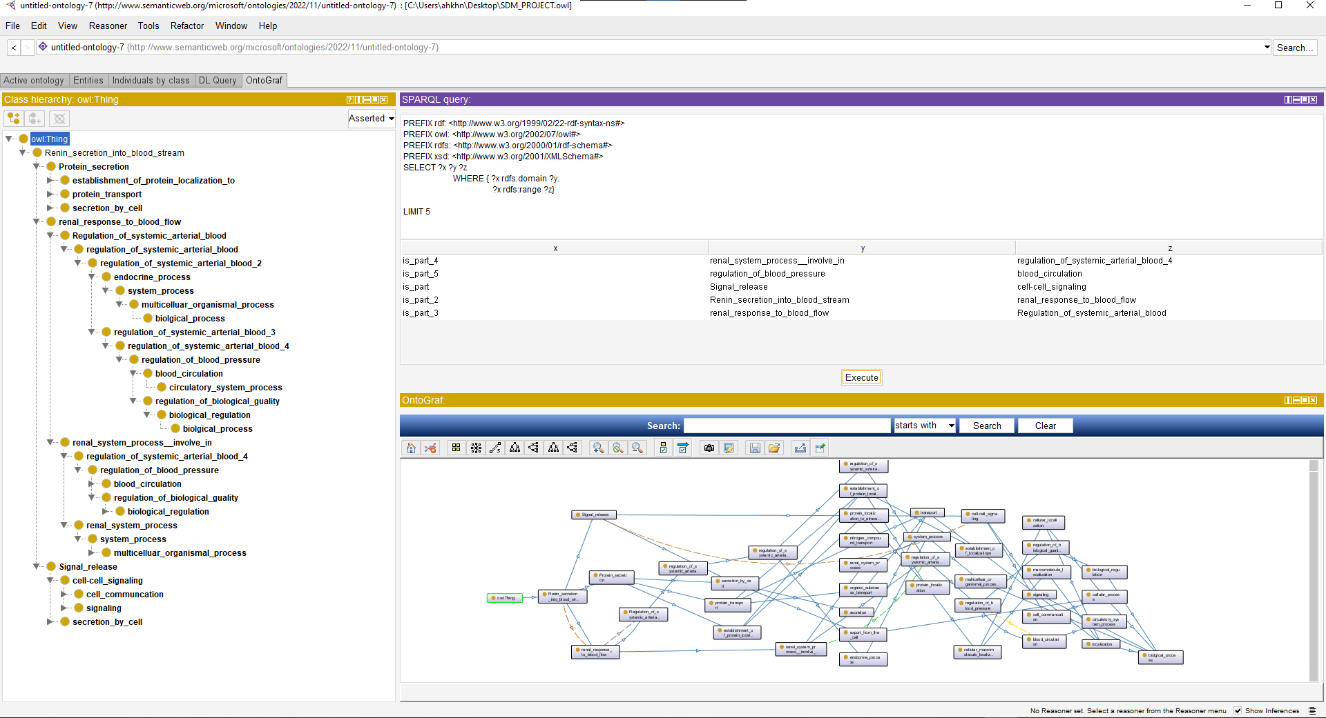
SPARQL

Slide 36
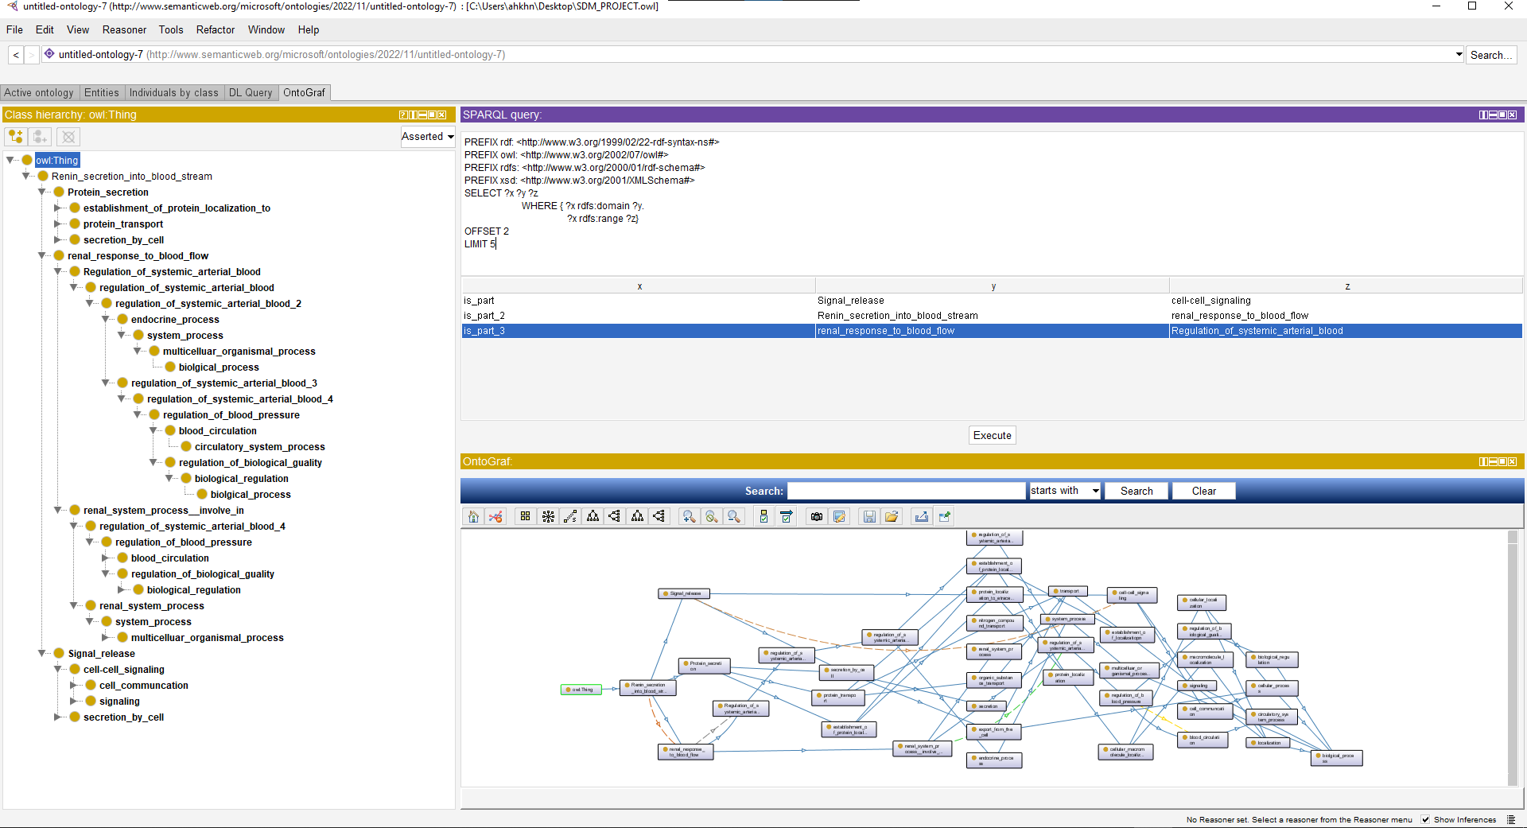
SPARQL

Slide 37
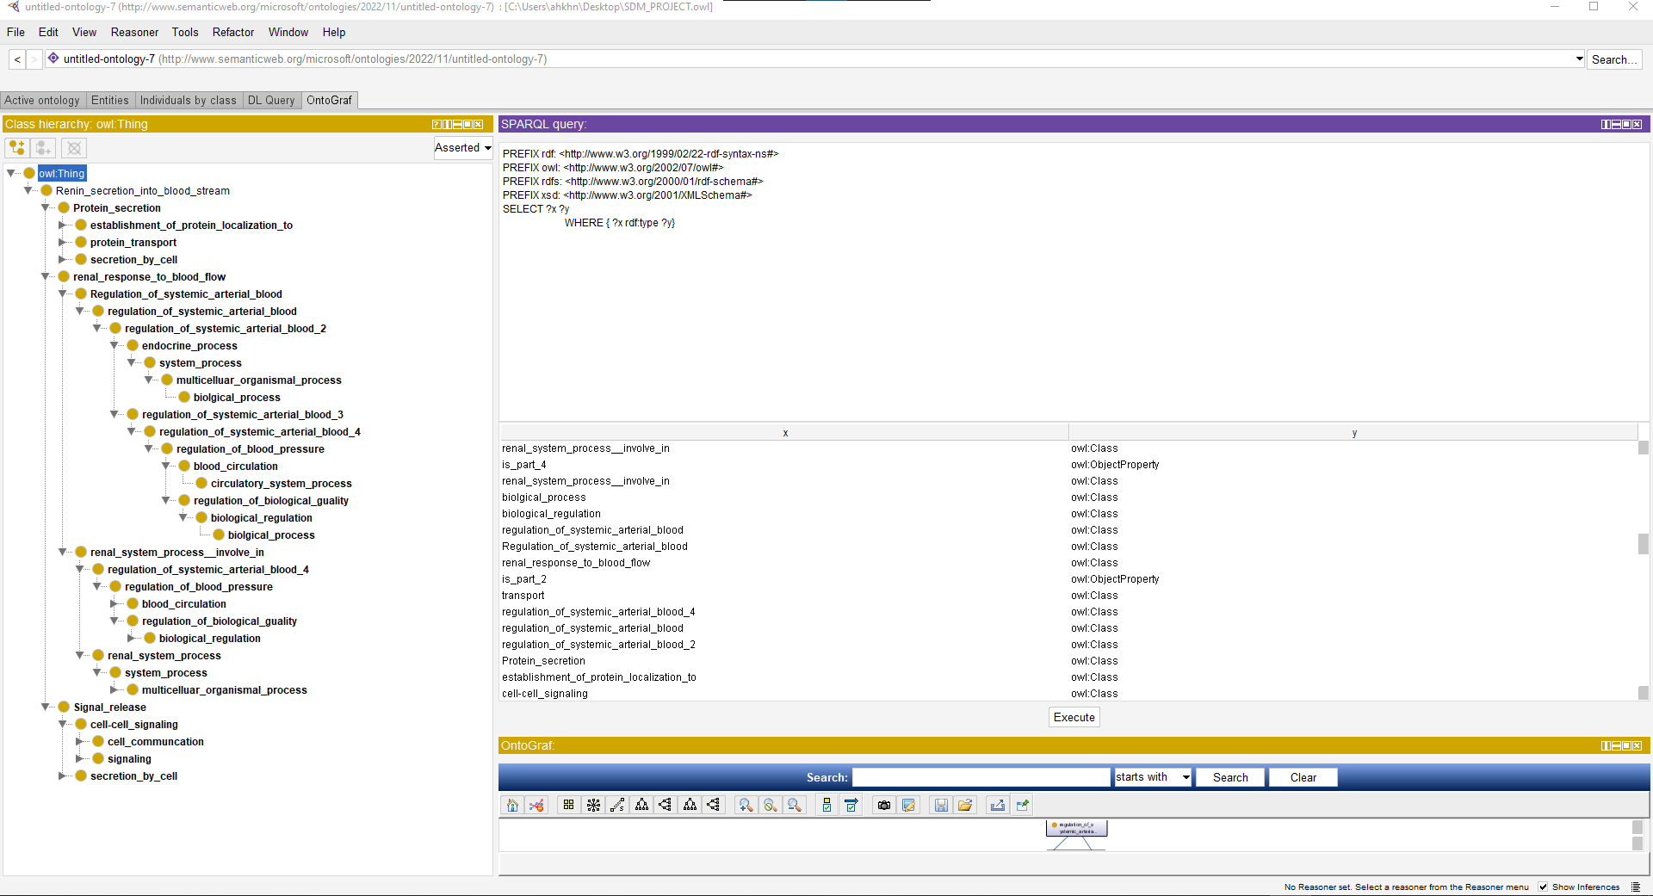
SPARQL

Slide 38
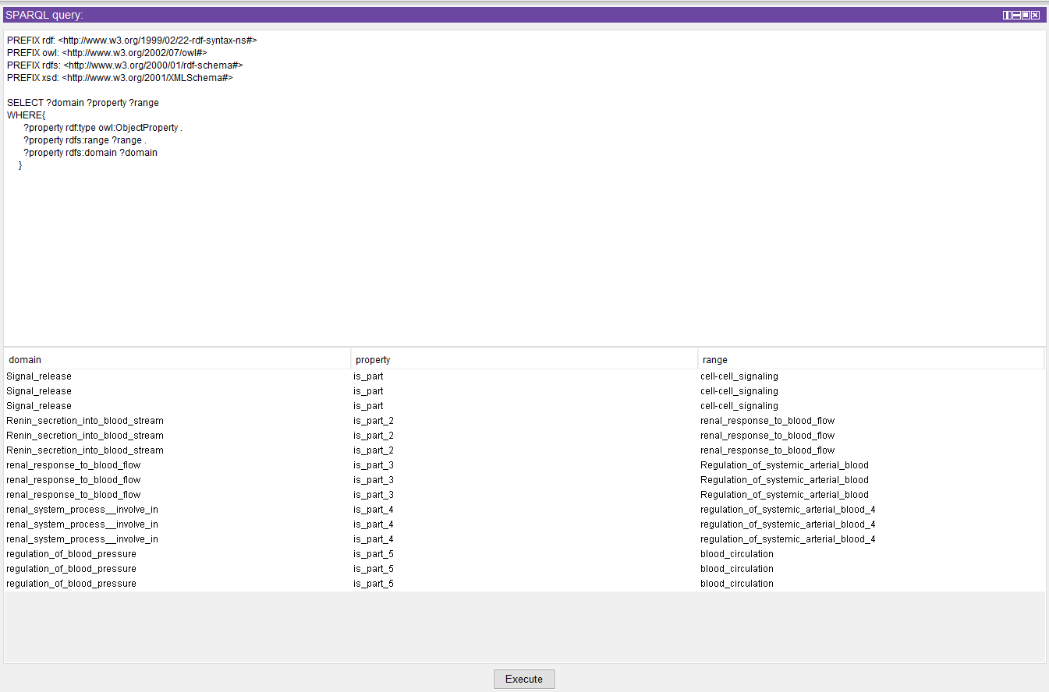
SPARQL

Slide 39
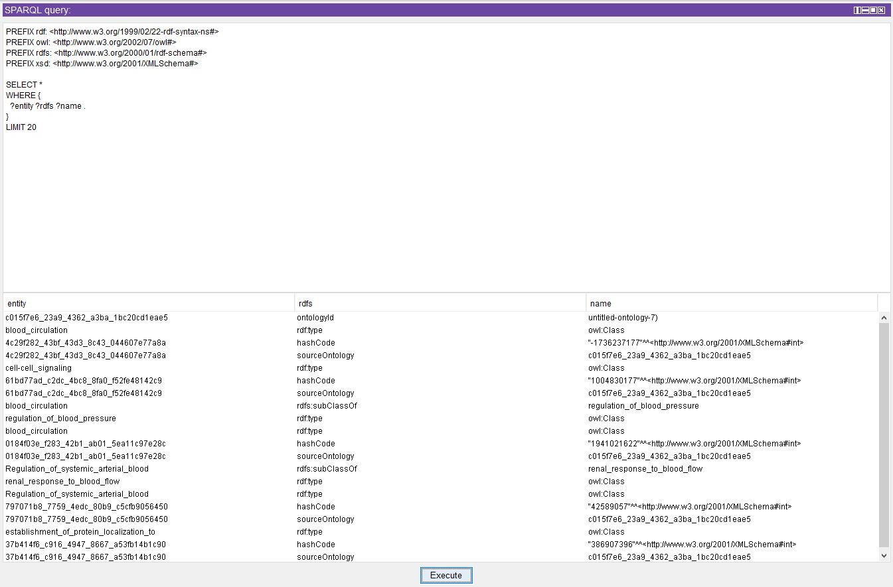
SPARQL

Slide 40
Annotation
05
Annotation on the data using Right field application after Ontology.

Slide 41
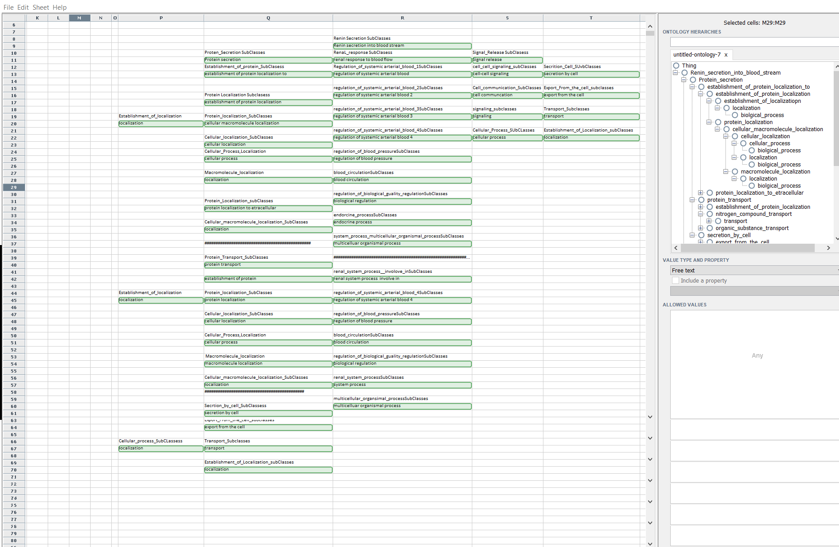
Result on Right Field Application

Slide 42
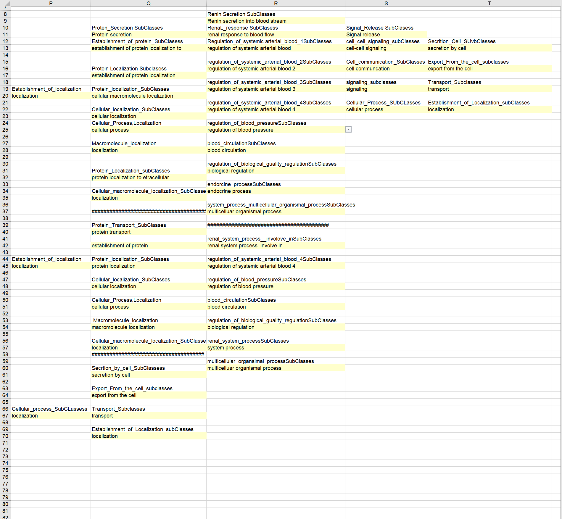
Result on Excel (.csv file)

Slide 43
Prediction
06
GUI to predict possibility of having chronic kidney disease using neural network algorithm to construct model.

Slide 44
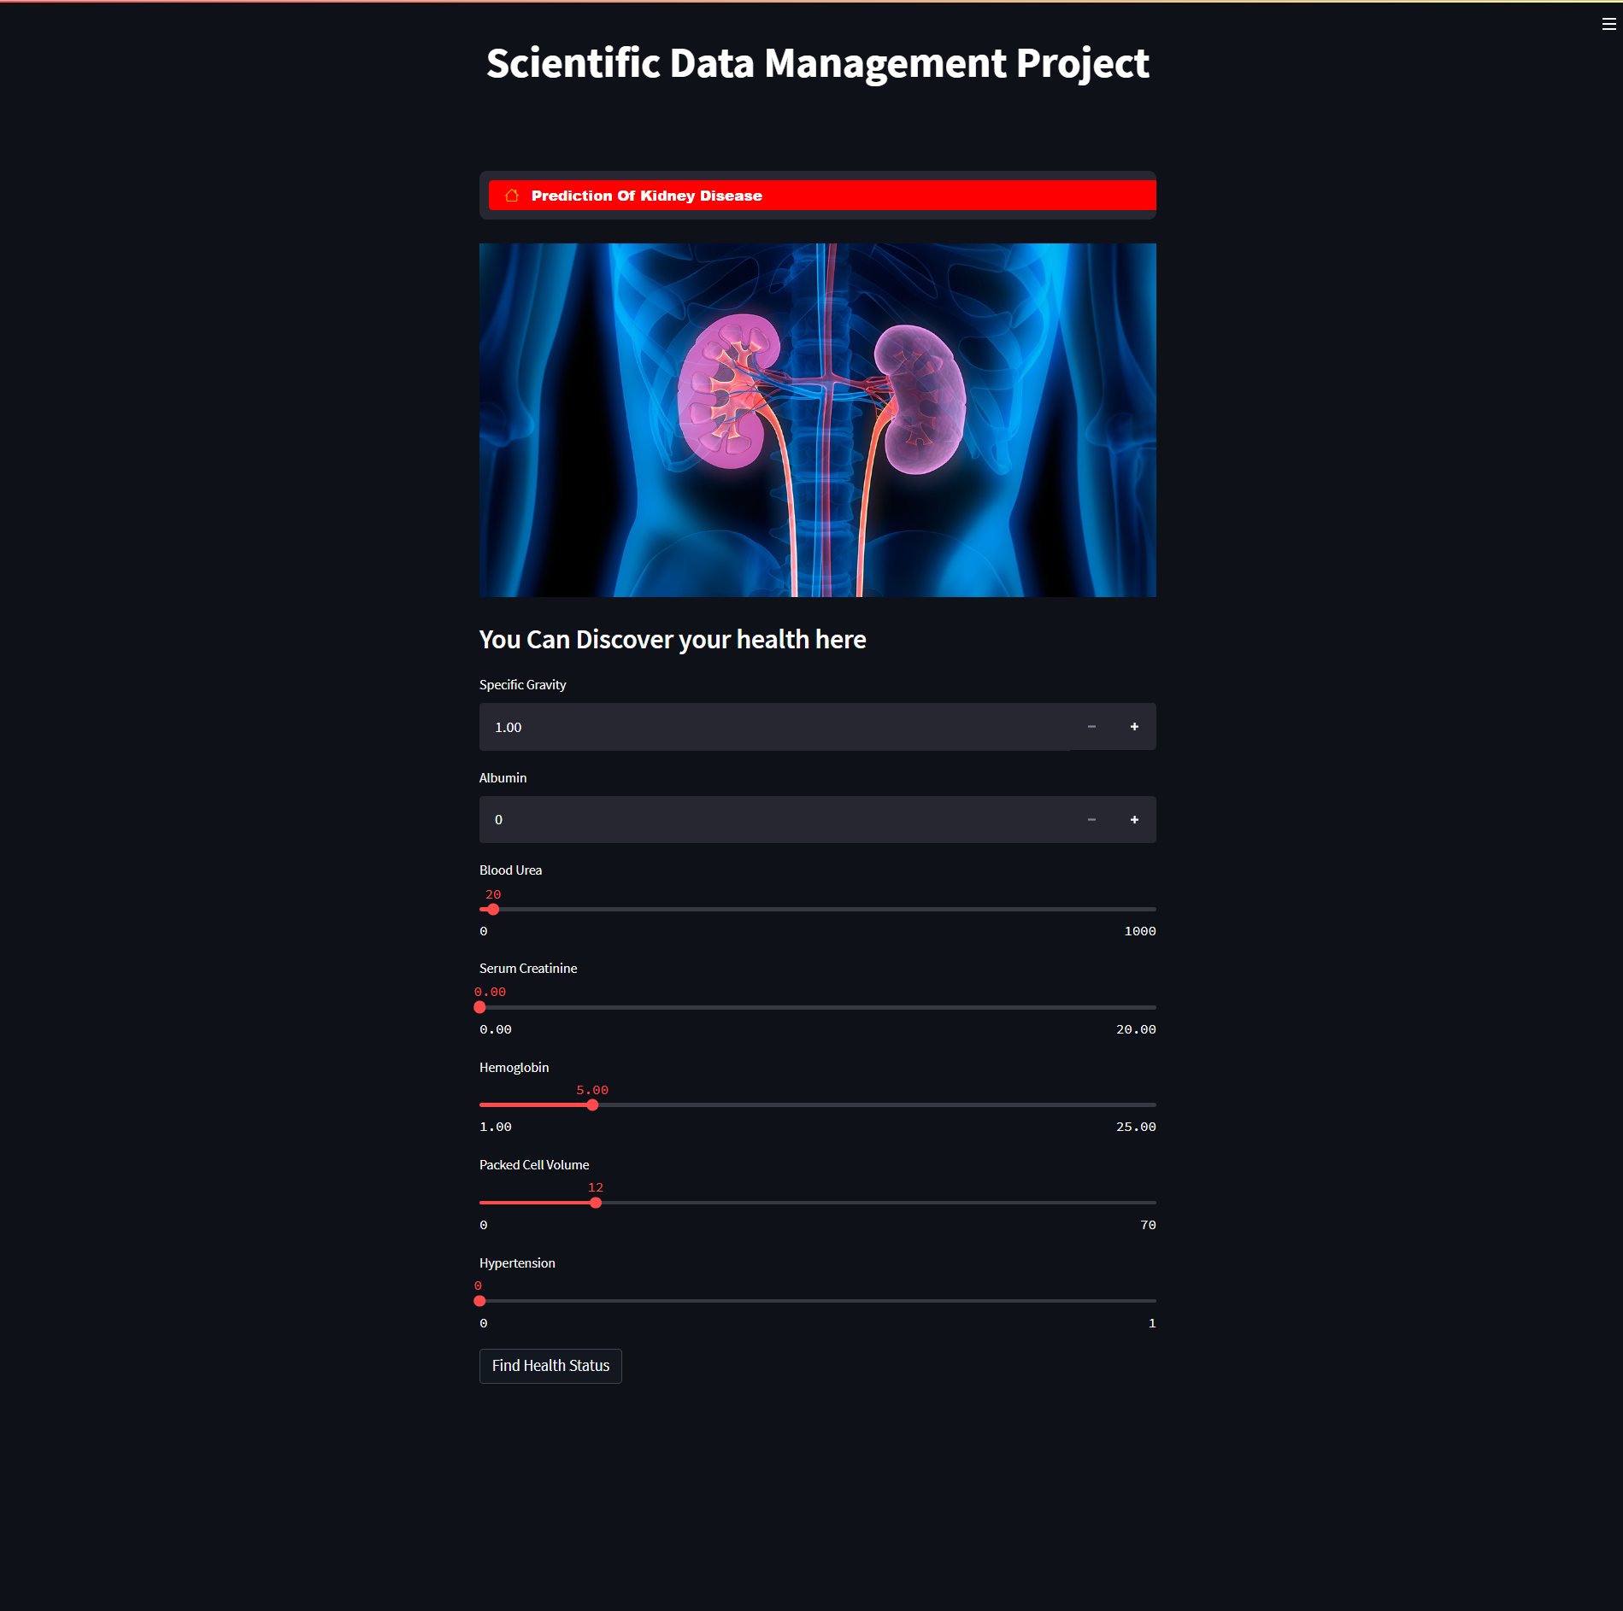
Website to detect chronic kidney disease possibility.

Slide 45



THANKS

